Slide 1
Single User WiFi Structure from Motion for Localization
Yiming Qian
University of Manitoba
https://yi-ming-qian.github.io/

Slide 2
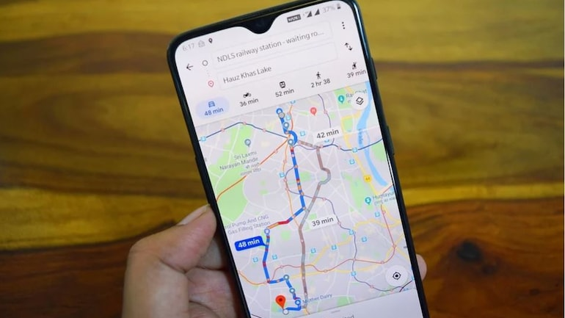

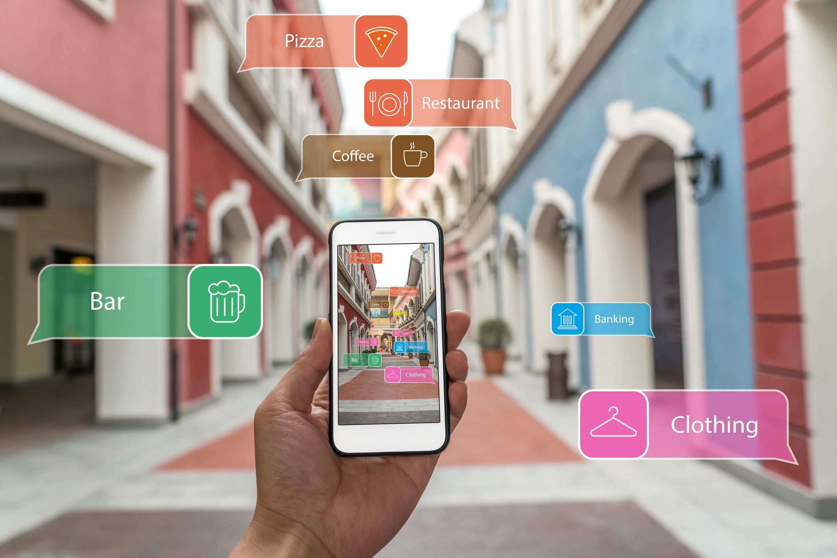
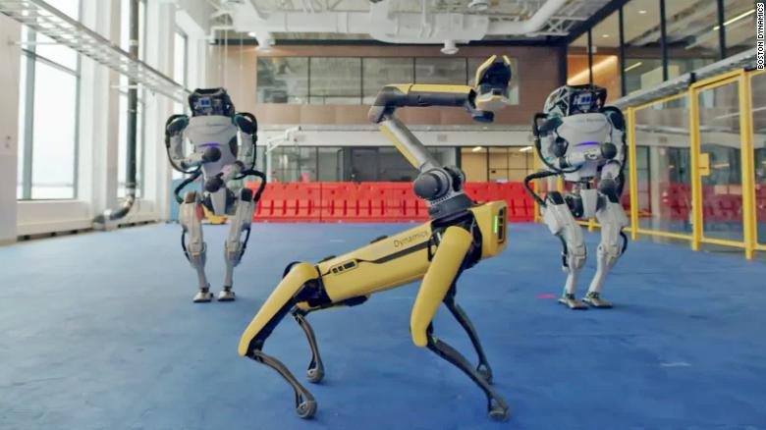
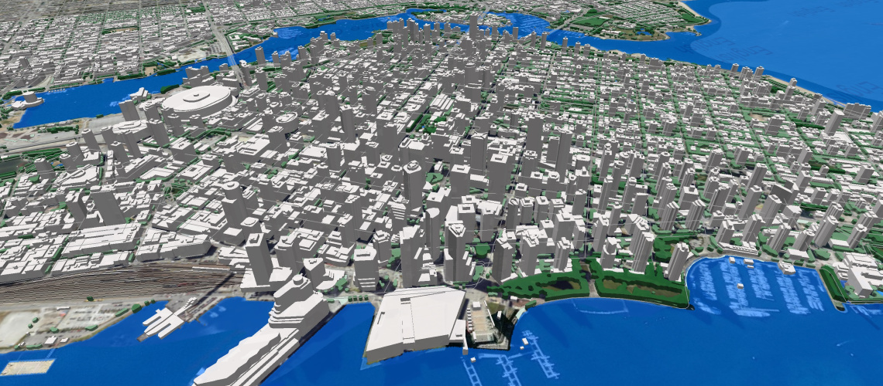
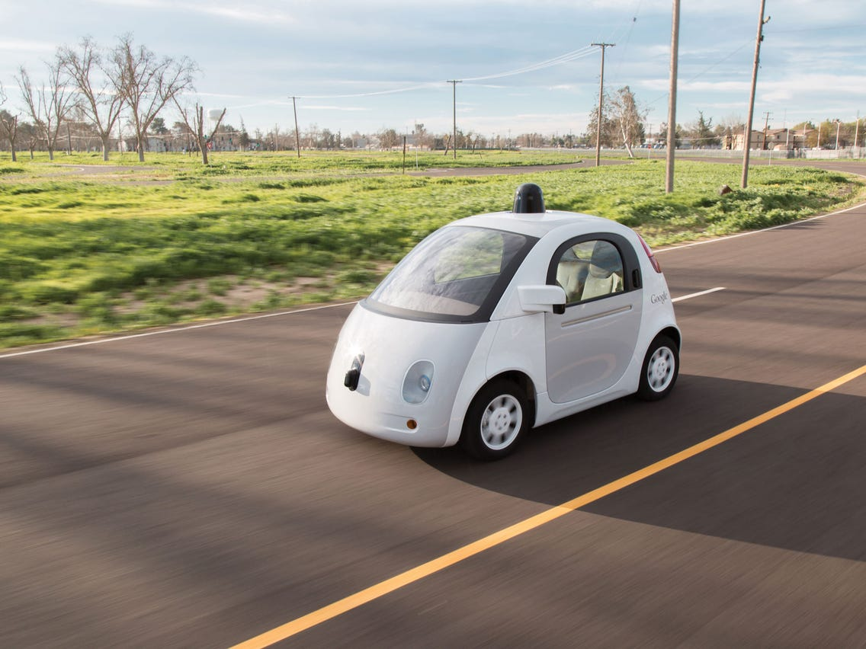
Impact of Positioning Systems
Maps phone APP
Contact tracing
Augmented reality
Robotics
Digital mapping
Autonomous vehicle

Slide 3
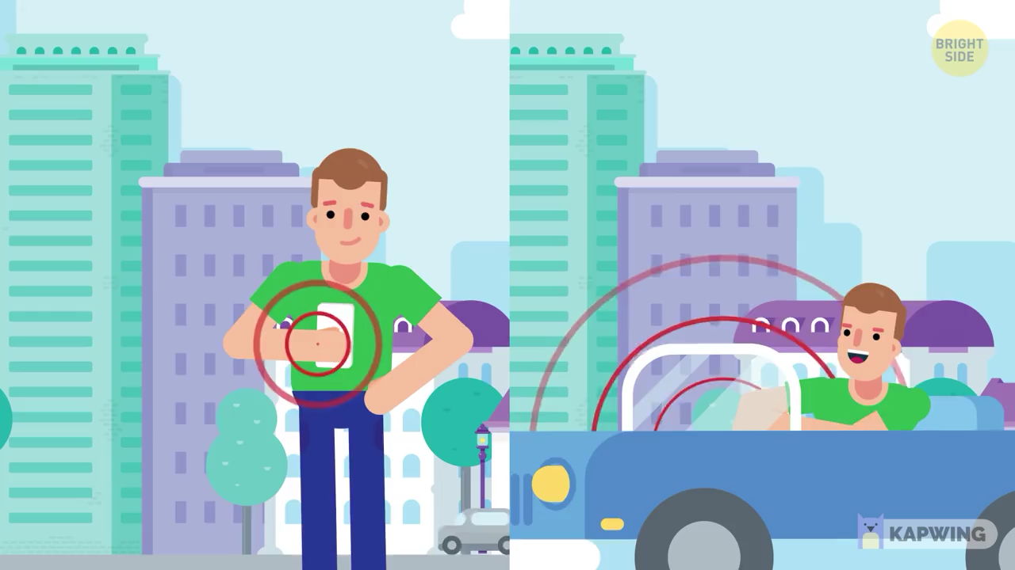
Notes:
A GPS system consists of a

Slide 4
Satellite GPS is not robust in indoor environment. Indoor GPS is a dream technology.

Slide 5
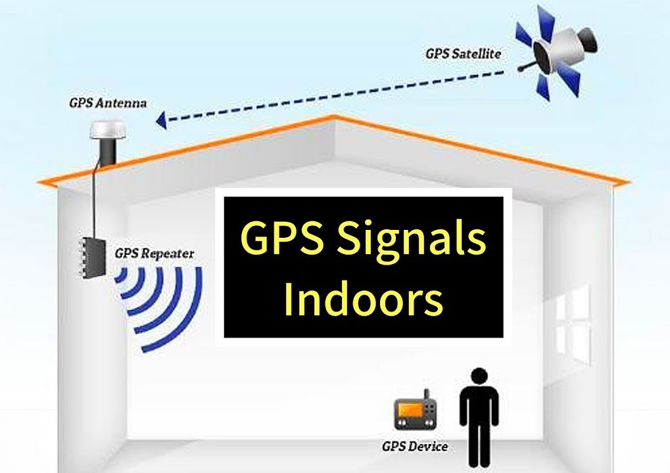


Certain equipments are required
Multi-path propagation

Slide 6
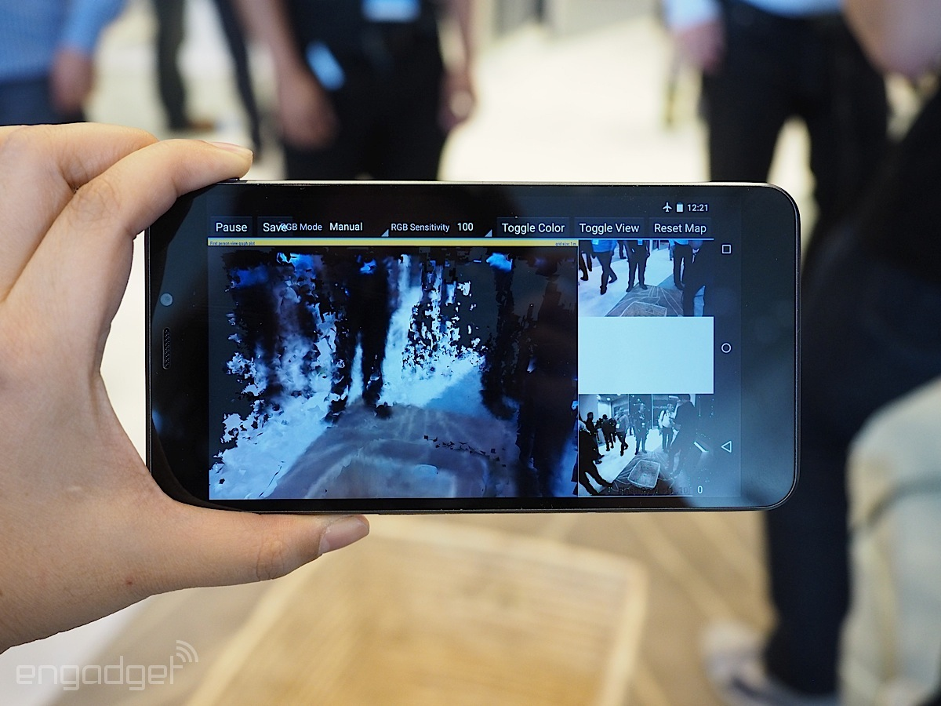
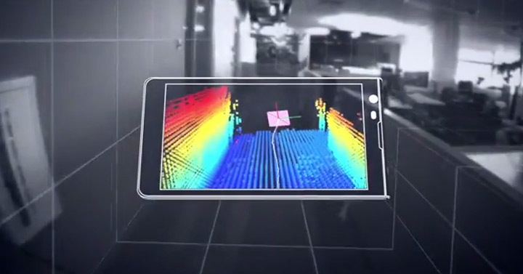
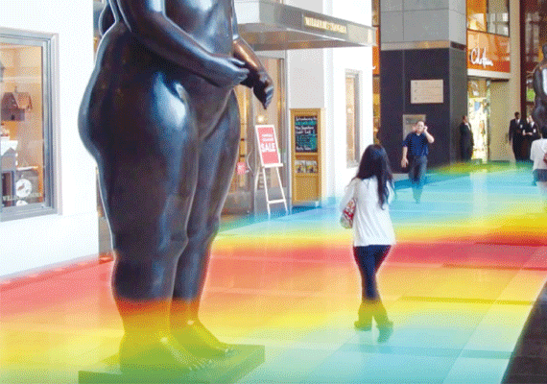
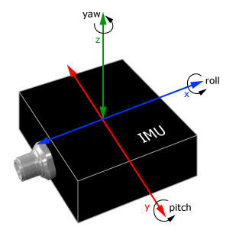
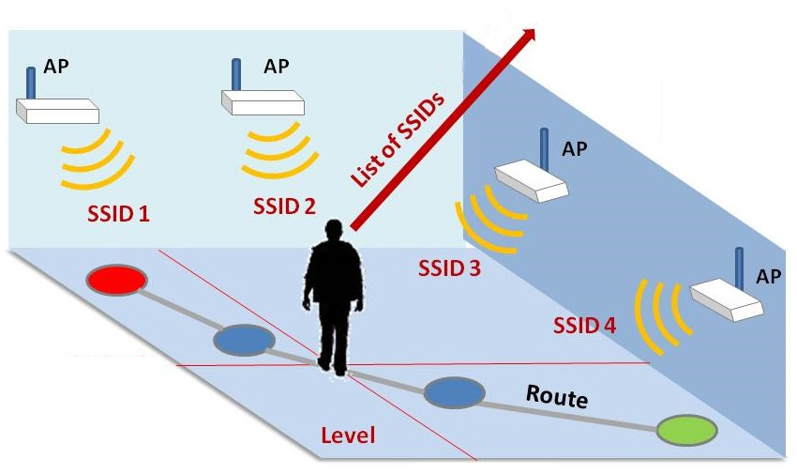
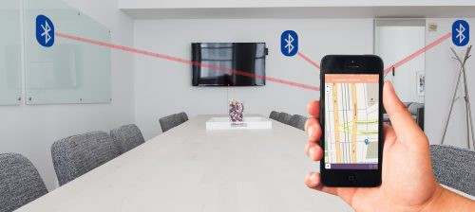
Alternative sources…
Image from camera
Depth from RGBD sensor
Magnetic field
Inertial Measurement Unit (IMU)
WiFi
Bluetooth

Slide 7
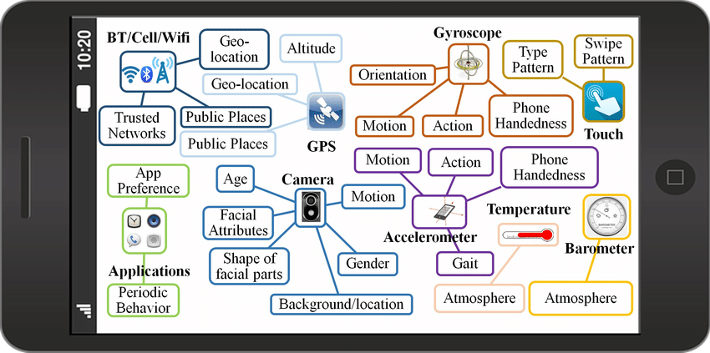
What you need is just a smartphone

Slide 8
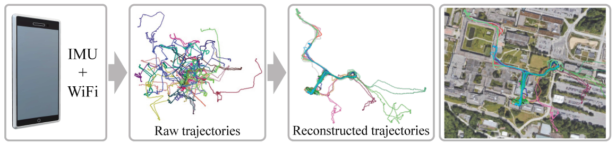
WiFi + IMU for localization
Low energy cost
Working anytime anywhere

Slide 9
Outline
Background and related works
Our approach
Experiments
Other projects

Slide 10
Outline
Background and related works
Our approach
Experiments
Other projects

Slide 11
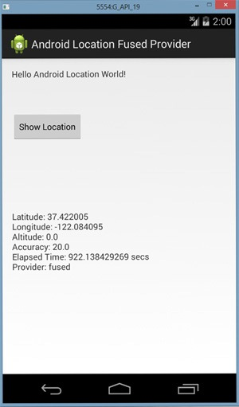
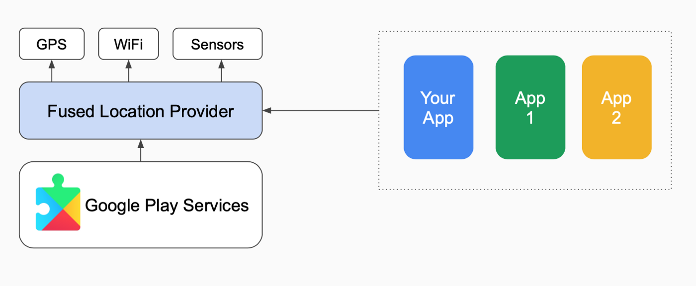
Fused Location Provider API
A sensor fusion approach

Slide 12
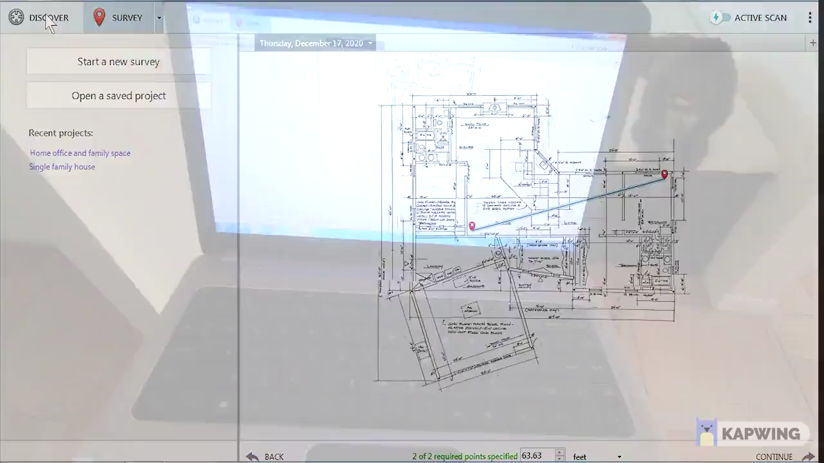
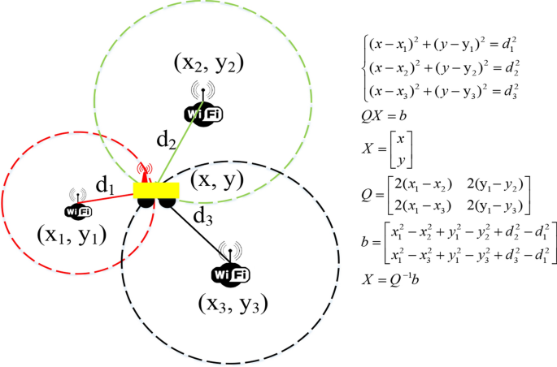
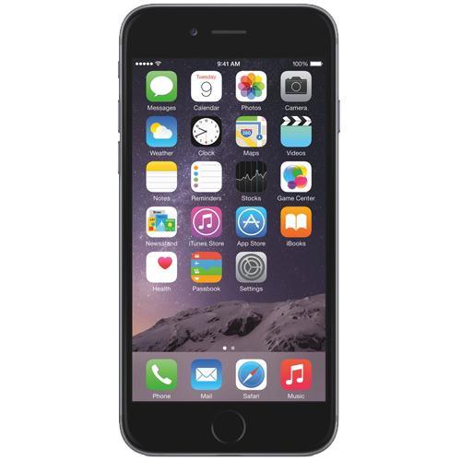
WiFi positioning systems
Site survey
Trilateration
1. Laborious; 2. Small scale; 3. Multi-path fading issue

Slide 13
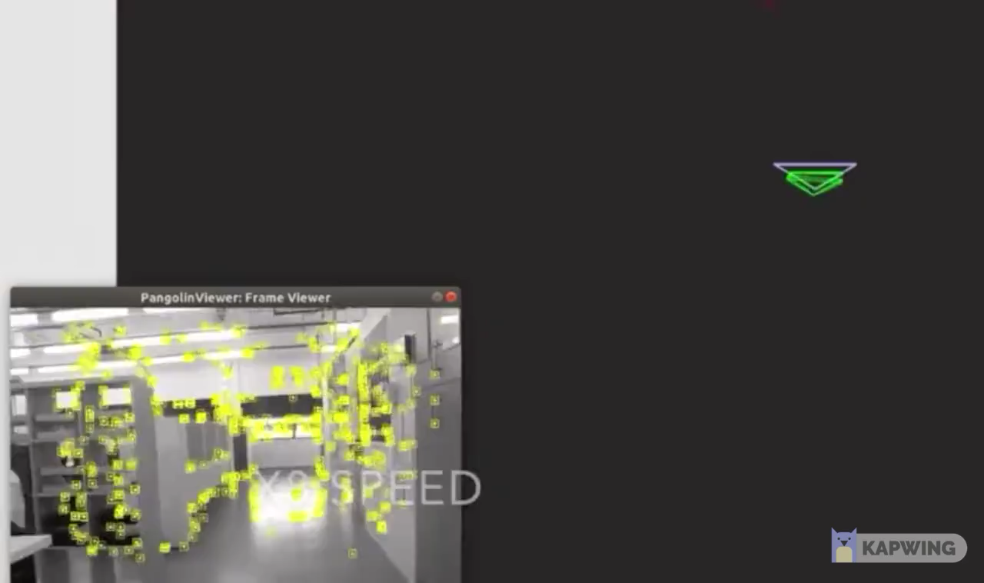
WiFi positioning systems
Geo-coordinate [x, y]
Received signal strength indicators (RSSI) [-10, -50, -200, ….]
Visual or WiFi SLAM
Radio fingerprint map
Continuous data acquisition;
No real data in the wild (handheld, same starting point)

Slide 14
Our goal for constructing a radio map
Automated
Distributed
No costly labors are hired
Non–continuous data input
Harmonized with daily activities
Read emails, play games, carry in a pocket…
Scalable
Uncontrolled
38 days, 345 hours, 45 kilometers
Working in unknown environment

Slide 15
WiFi Structure from Motion
Unstructured WiFi and IMU sensor measurements
(potentially across different dates by different users)
Motion trajectories and a WiFi radio map in a single coordinate frame

Slide 16
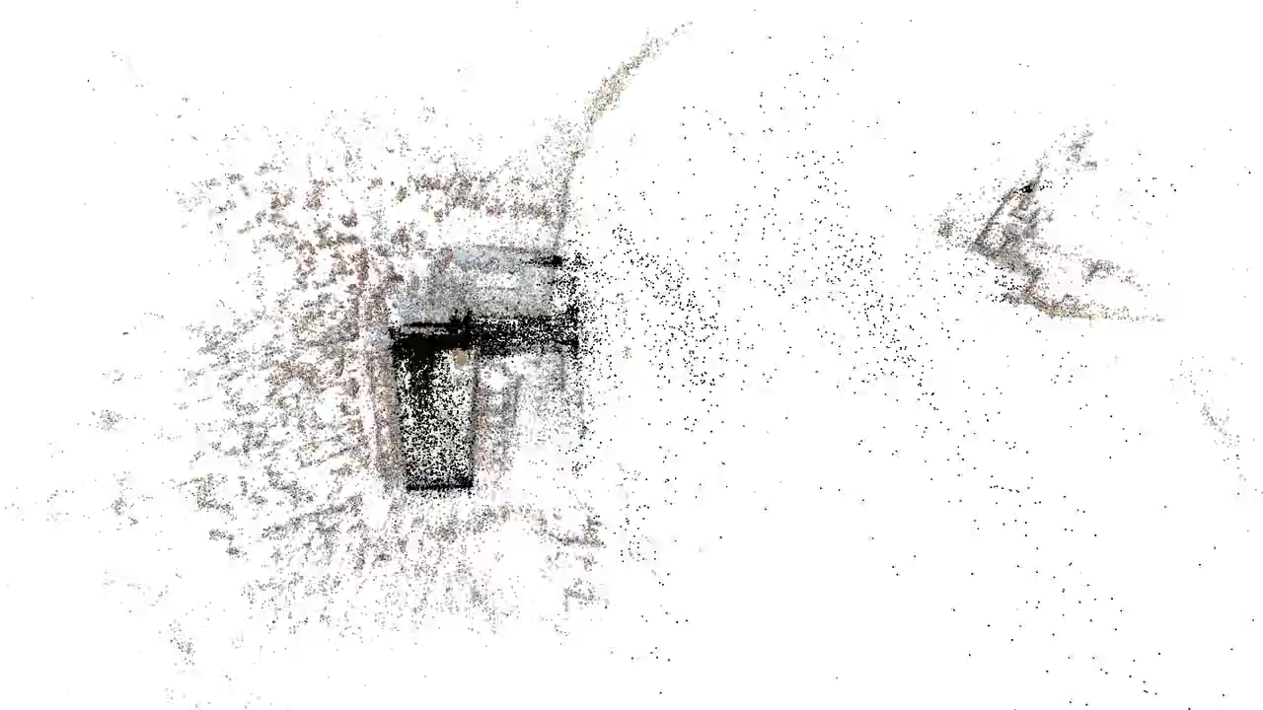
Visual Structure from Motion in Computer Vision
Input: Millions of unstructured images parsed from Internet
Output: 1. An entire 3D city model 2. Poses of all camara locations

Slide 17
Outline
Background and related works
Our approach
Experiments
Other projects

Slide 18
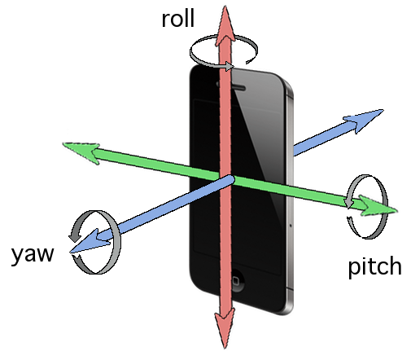
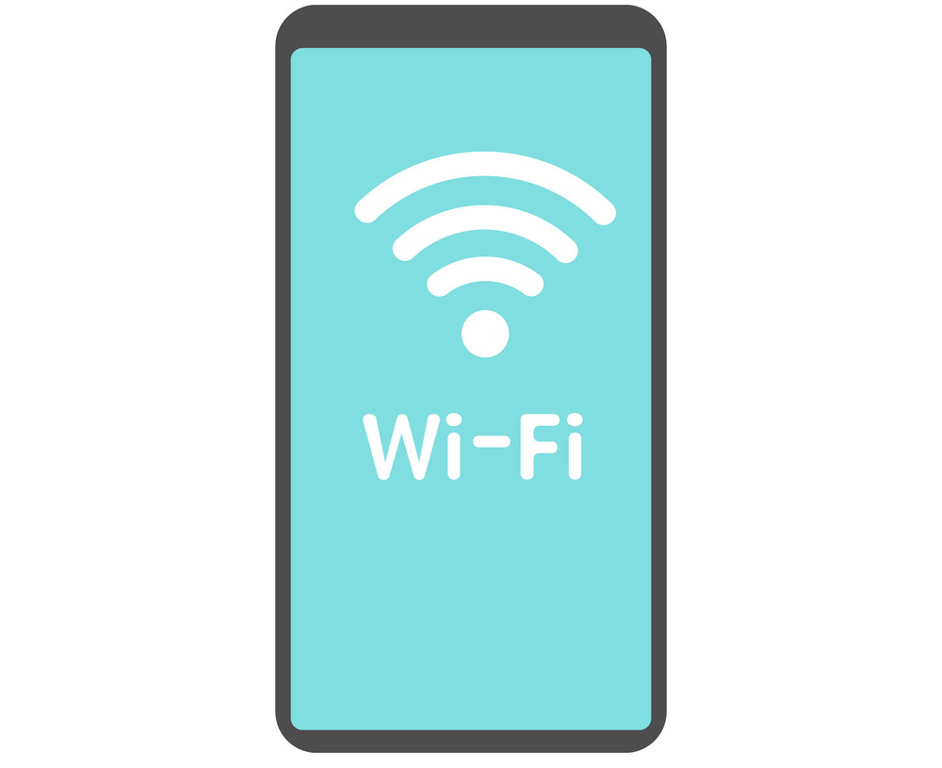
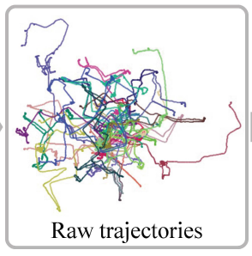
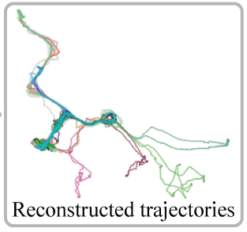
Inertial Navigation
RoNIN: https://ronin.cs.sfu.ca/
Relative motion by inertial navigation
Global motion

Slide 19
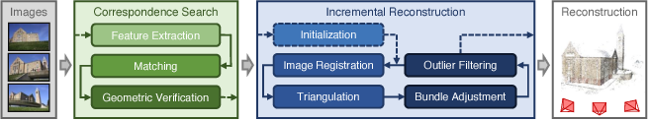
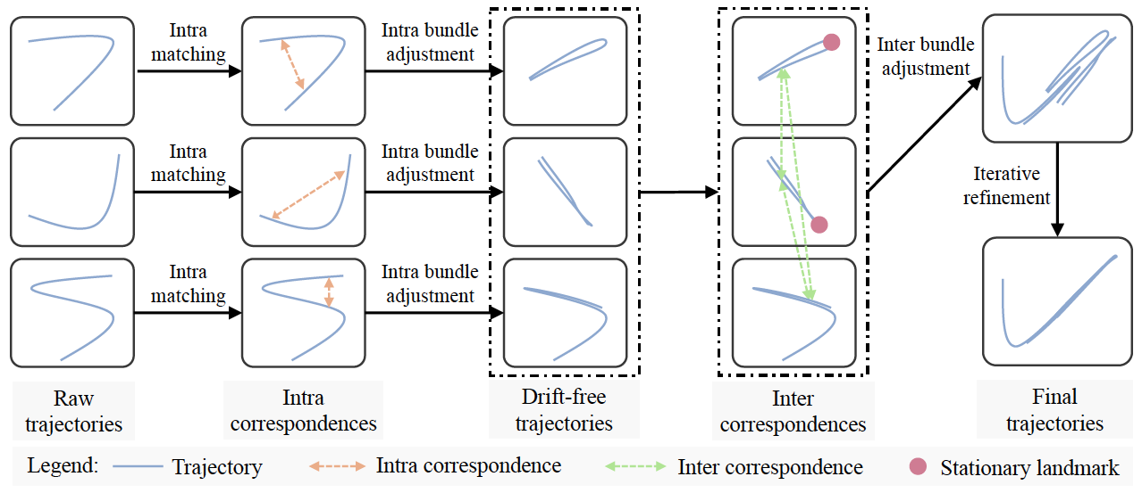
Visual SfM
WiFi SfM

Slide 20
Technical Distinctions
Human motions are repetitive.
Humans do not keep moving 24 hours a day -> stationary landmarks.
Everyday, you walk the same routes to the same office.
Reconstructed motion should be consistent with RSSI-based positioning.

Slide 21
Correspondence matching
IMU relative trajectories
Angular velocity from Android API
Intervals of stationary frames
Intervals of non-stationary frames
Mean-shift clustering using RSSI
Nearest neighborhood search using RSSI
Stationary landmarks
Intra-trajectory correspondence
Inter-trajectory correspondence

Slide 22
Reconstruction

Slide 23
Intra Bundle Adjustment

Slide 24
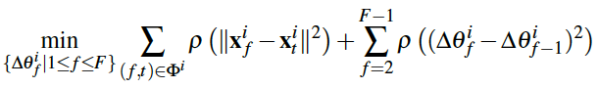

Intra Bundle Adjustment
where,
$x_{f}^{i}$ is the 2D location at frame $f$
$x_{0}^{i}=[0, 0]$ is the starting point
$v_{t}^{i}$ is the velocity magnitude from RoNIN
$θ_{t}^{i}$ is the heading direction angle from RoNIN
$Δθ_{t}^{i}$ is the angle correction value

Slide 25
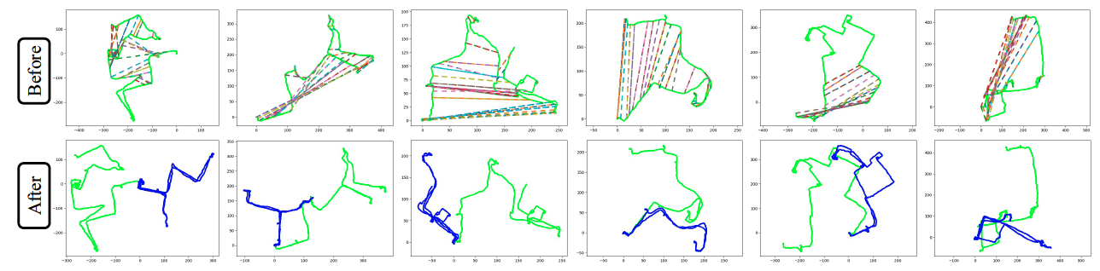
Intra Bundle Adjustment

Slide 26
Inter Bundle Adjustment

Slide 27
Inter Bundle Adjustment
Non-linear least square optimization
Three terms:
Spatial consistency term
Smoothness term
Stationary consistency term

Slide 28
Iterative Refinement

Slide 29


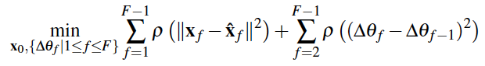



Iterative Refinement
Weight network
0.2
0.3
0.5
Training loss is:
$$($$
$$− (0.2$$
+ 0.3
+ 0.5
${))}^{2}$
Final bundle adjustment
They should be very close.
Reference
Nearest Neighbors

Slide 30
Outline
Background and related works
Our approach
Experiments
Other projects

Slide 31
Dataset
An Android app was developed to record IMU and WiFi sensor data
We collect accelerations (200Hz), angular velocities (200Hz), and device orientations (100Hz).
The WiFi receiver records RSSIs and the MAC addresses at 1Hz.
A Samsung Galaxy S9 was used by a single individual as part of daily activities for 38 days.
Average duration of 6.2 hours and average travel distance of 1.2 kilometers per day, covering approximately 550mx580m space.

Slide 32
Test dataset
Google Tango phone (Asus Zenfone AR) was used.
WiFi RSSIs (1Hz), Google FLP results (1Hz), and 6 DoF poses from visual SLAM (200Hz), which is used as ground-truth.
22 raw trajectories, an average duration of 2.7 minutes,

Slide 33
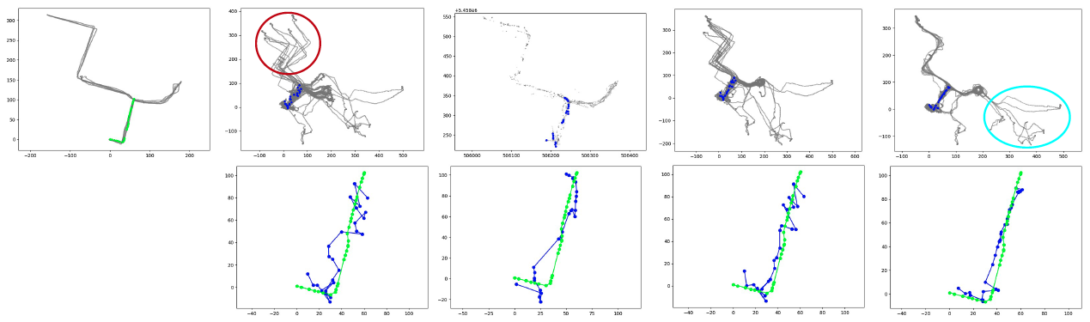
Qualitative Results
Tango query
C-SLAM-RF
Google FLP
Ours w/o refine
Ours

Slide 34
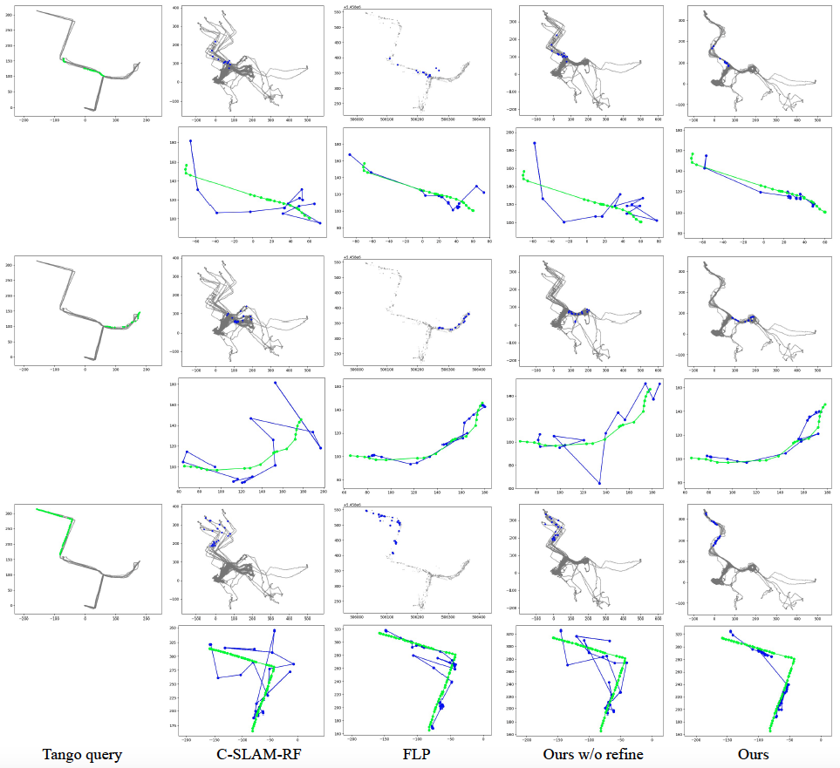

Slide 35
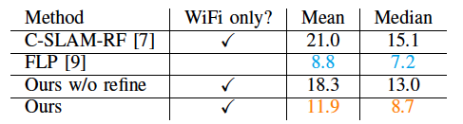
Quantitative evaluation on localization

Slide 36
Outline
Background and related works
Our approach
Experiments
Other projects

Slide 37
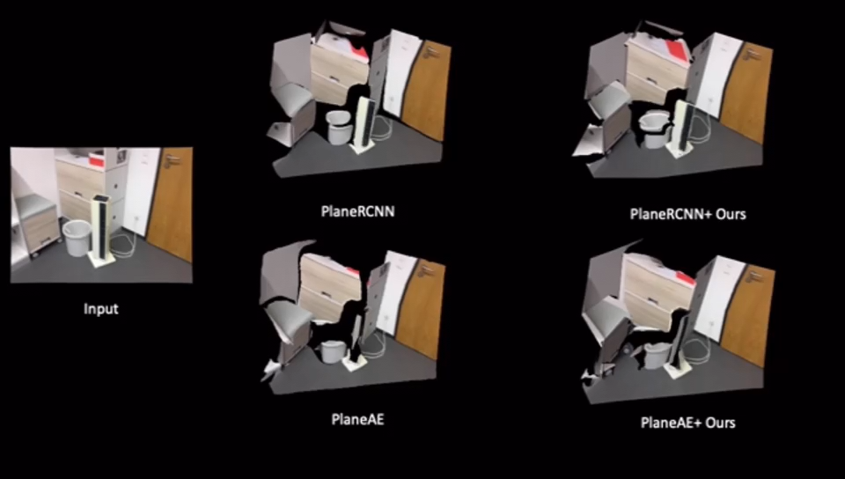
Indoor planar reconstruction for AR
Notes:
This is a project that I completed last year. It is for the application of Augmented reality. Using a cell phone, we capture a single image, our method is able to recover the 3d geometry of an indoor scene. Rather than representing the geometry with a point cloud or depth map, our method represent the scene with plane segments. In this video, the first column show the RGB input, the second shows results by previous methods. There are

Slide 38
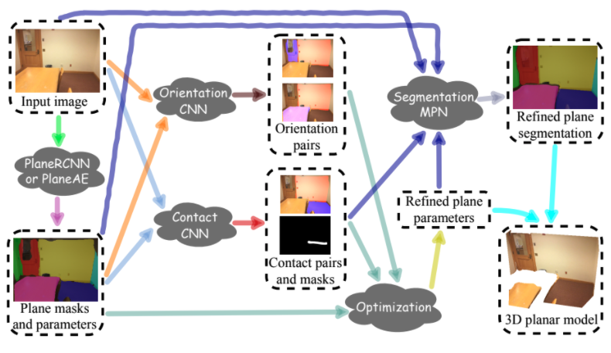

Slide 39
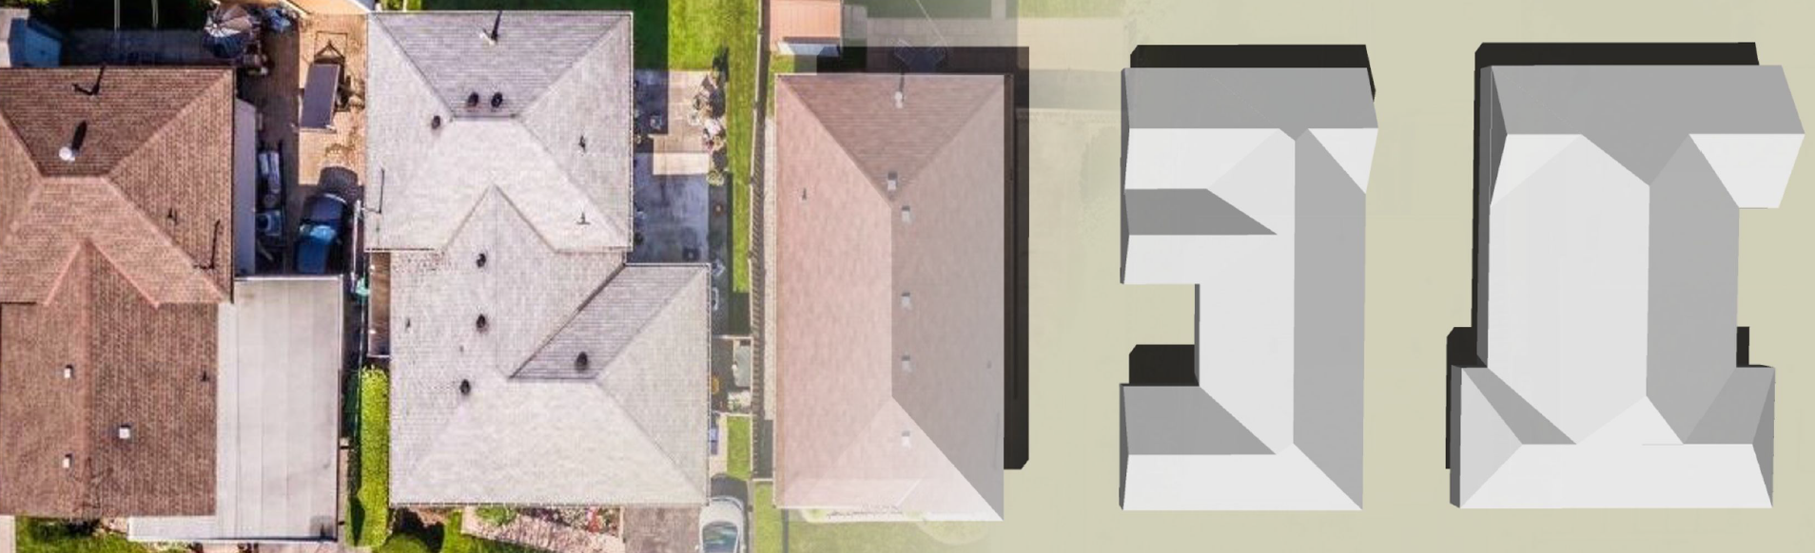
Roof generation for residential houses

Slide 40
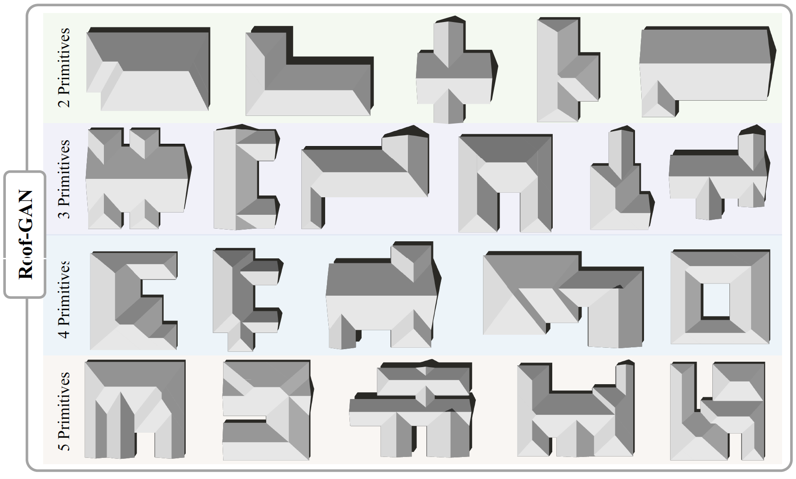
Our method

Slide 41
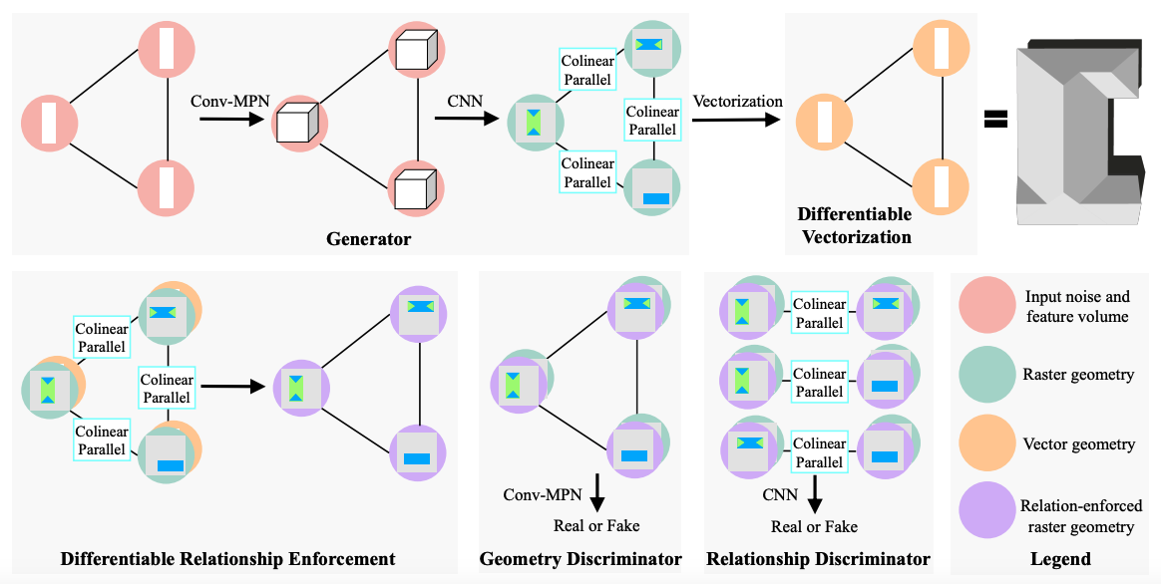

Slide 42
Thank You!

